Slide 1
Marketing and Retail Analytics Project - Milestone 1

Slide 2
Agenda & Executive Summary of the data
Contents
* Data set and problem statement
* Exploratory Data Analysis and Inferences
* Customer Segmentation using RFM analysis
* Inferences from RFM analysis and Recommendations
Problem statement
An automobile parts manufacturing company has collected data of transactions for 3 years. They do not have any in-house data science team; thus they have hired you as their consultant. Your job is to use your magical data science skills to provide them with suitable insights about their data and their customers

Slide 3
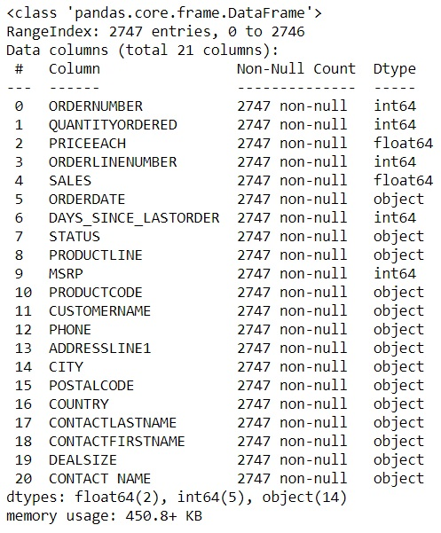
About data set
The given dataset contains 2747 rows and 21 columns of data.
It has two float data type, five integer data type and 14 object data type of columns.
The dataset has both no null values and no duplicate rows of data
There is presence of outliers in variables such as Quantityordered,Price and Sales.
Variable ‘Sales’ has highest positive skewness(0.784) and Variable ‘Days_since_lastorder’ has lowest negative skewness(-0.002)

Slide 4
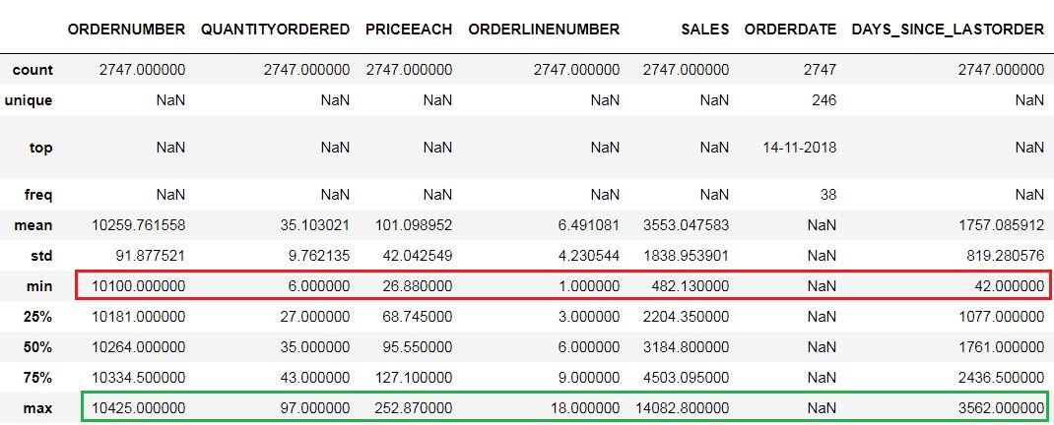
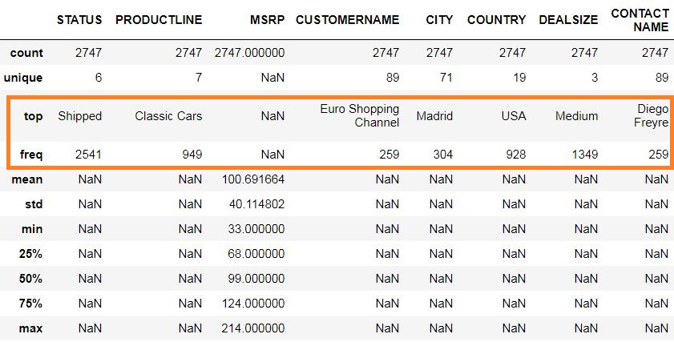
Maximum and Minimum values for respective numerical variables are highlighted in Green and Red colors
Top and Freq for respective string variables are highlighted in Orange color

Slide 5
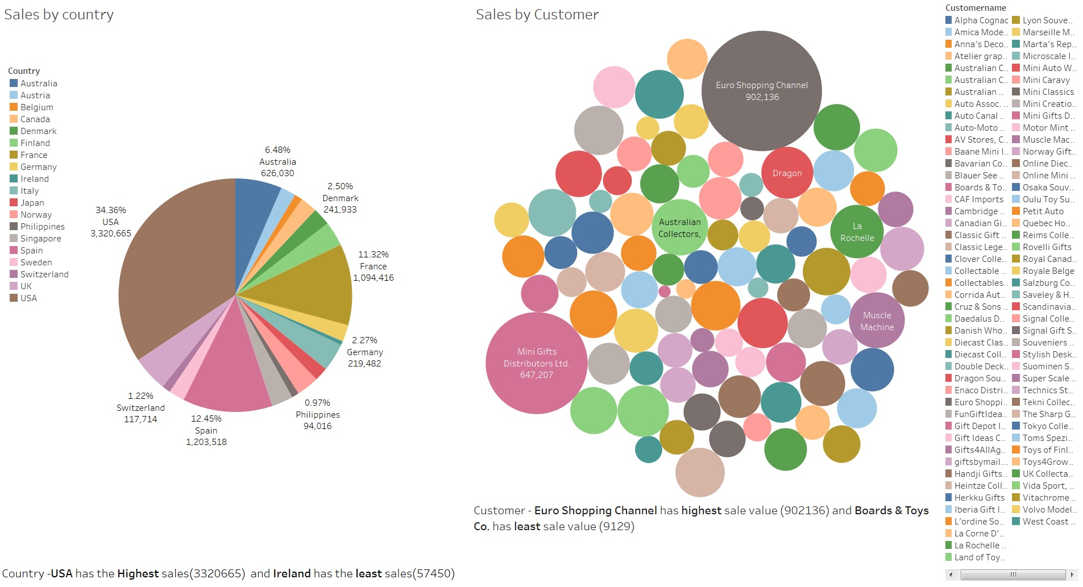
Exploratory Analysis and Inferences

Slide 6
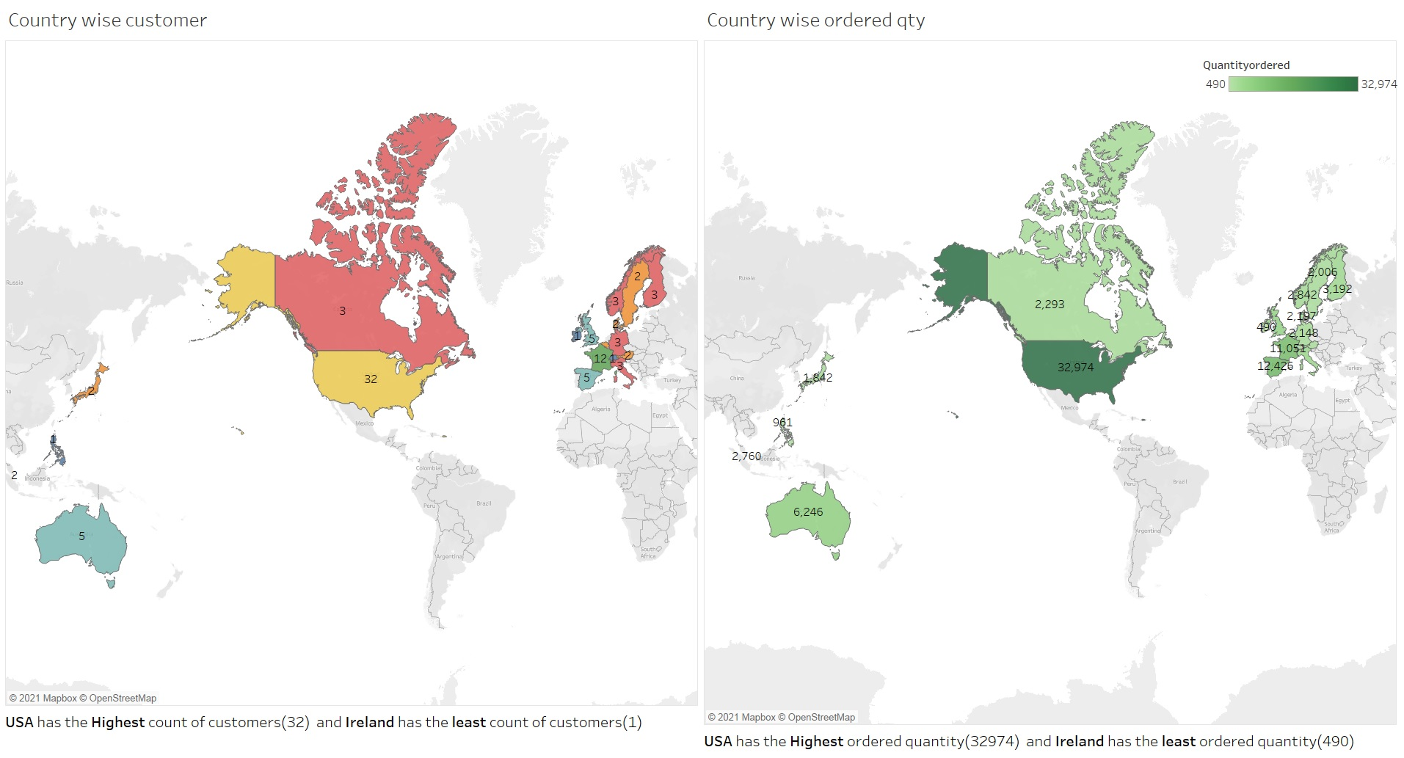

Slide 7
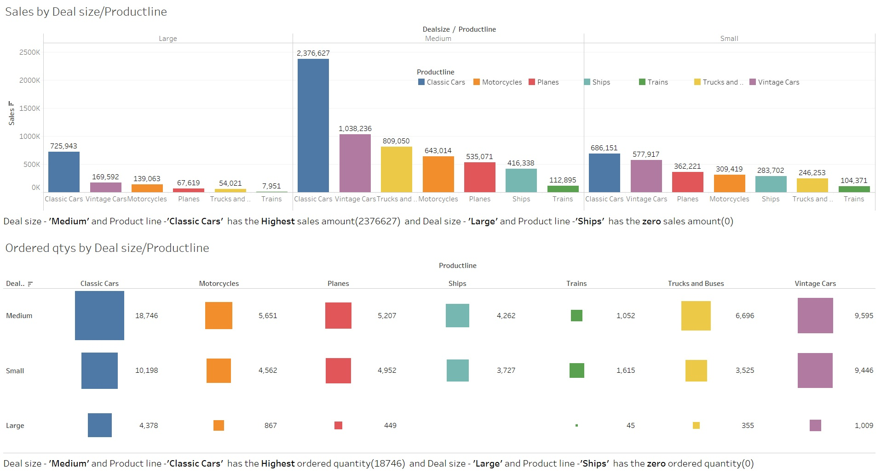

Slide 8
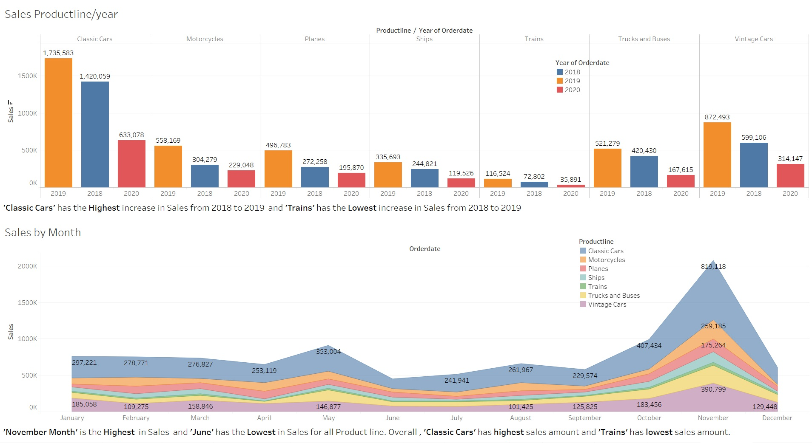

Slide 9
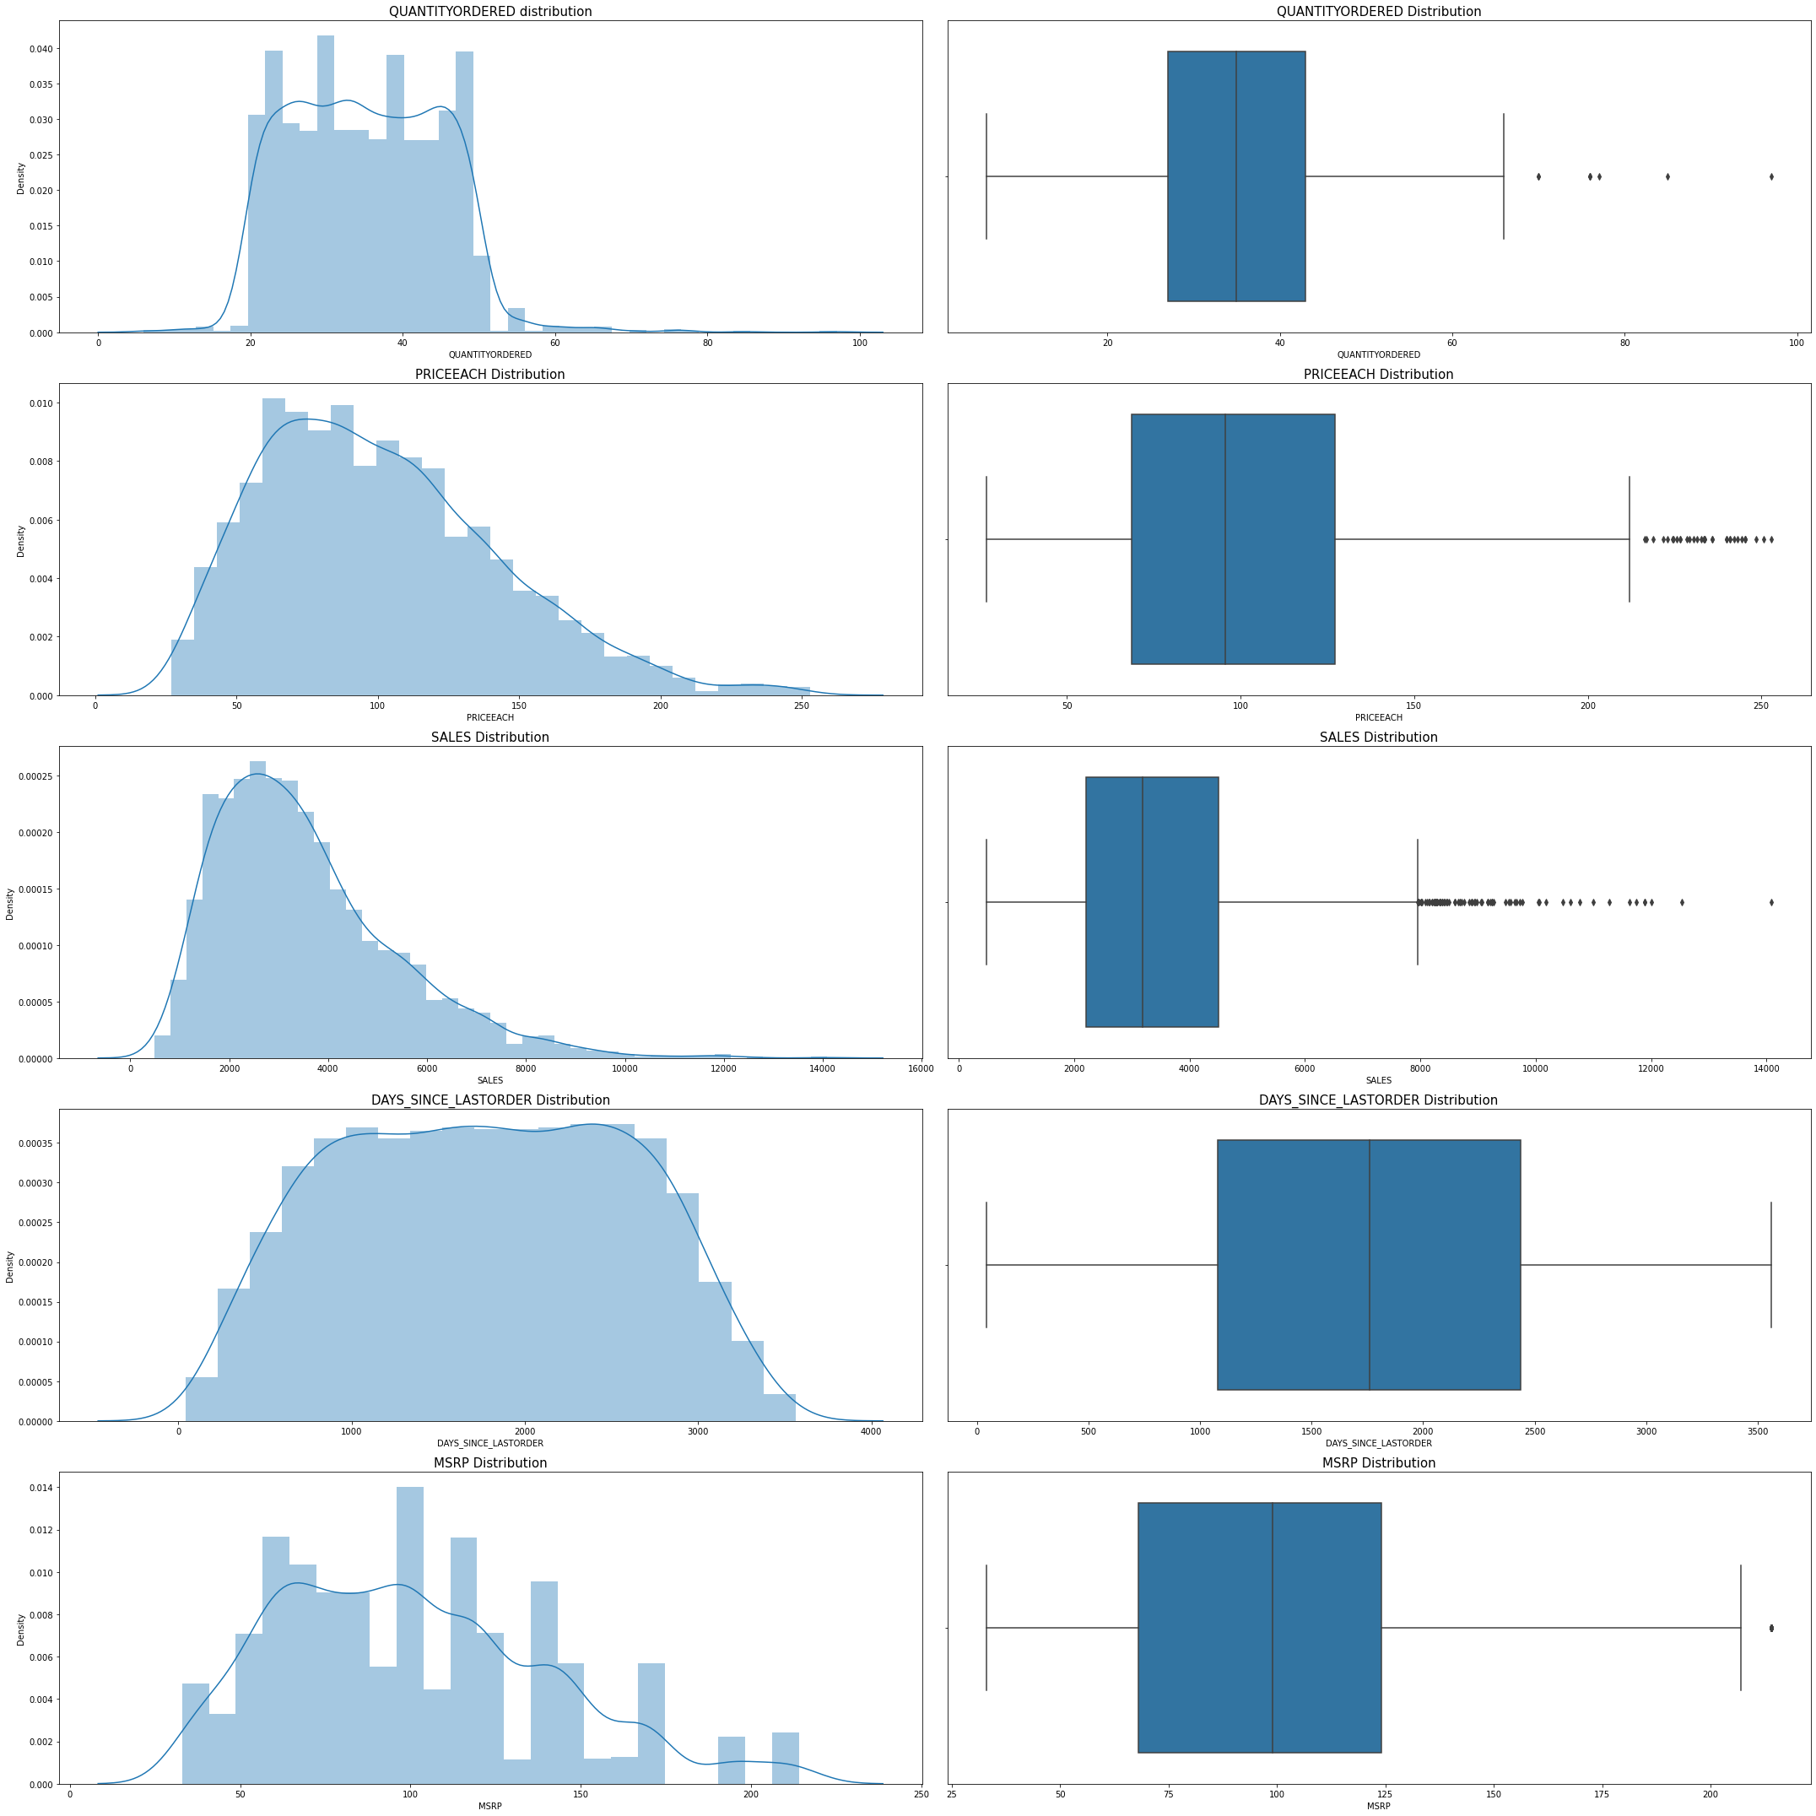
Distplot and Boxplot distribution
There is presence of outliers in variables such as Quantityordered,Price and Sales.
Variable ‘Sales’ has highest positive skewness(0.784) and Variable ‘Days_since_lastorder’ has lowest negative skewness(-0.002)

Slide 10
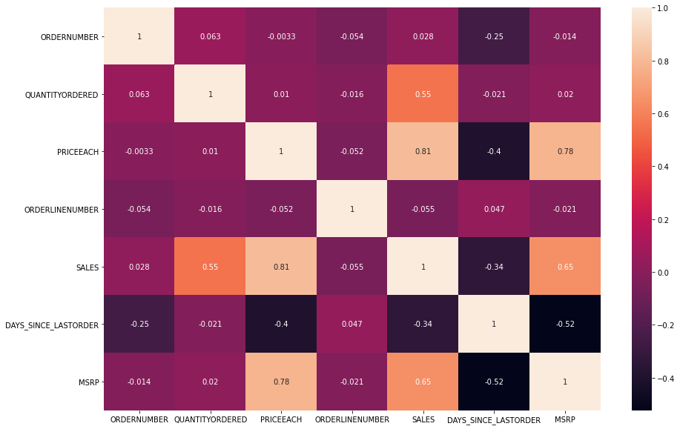
Heat Map
Variables ‘Sales’ and ‘Priceeach’ have highest positive Correlation(0.81) and Variables ‘Days_since_lastorder’ and ‘MSRP’ have highest negative Correlation(-0.52)

Slide 11
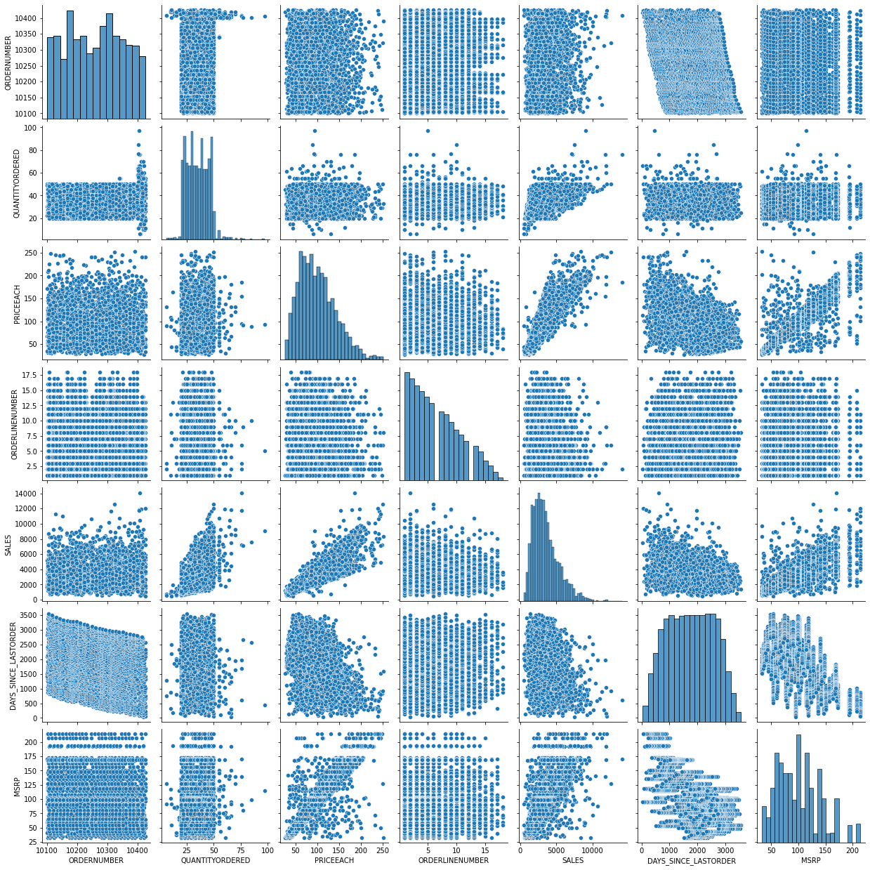
Pair Plot
From the plot , we can see that none of the variables are symmetric
Variables ‘Sales’ and ‘Priceeach’ have almost linear realtionship between them.

Slide 12
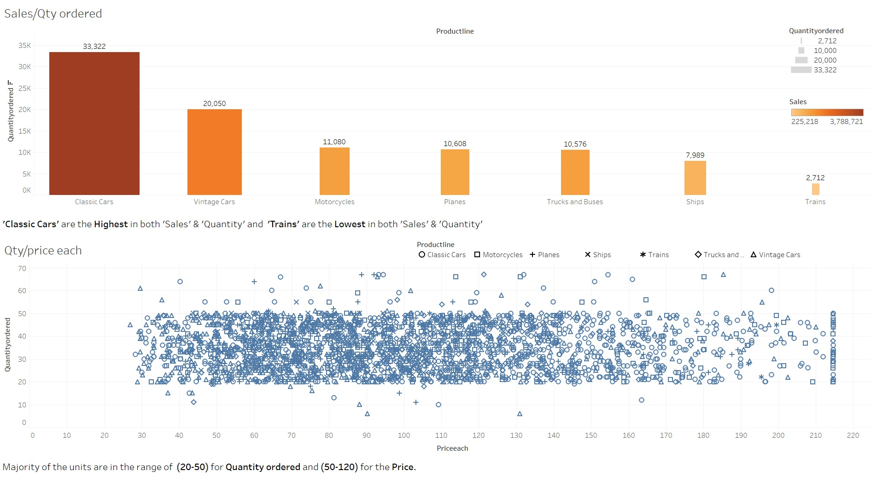

Slide 13
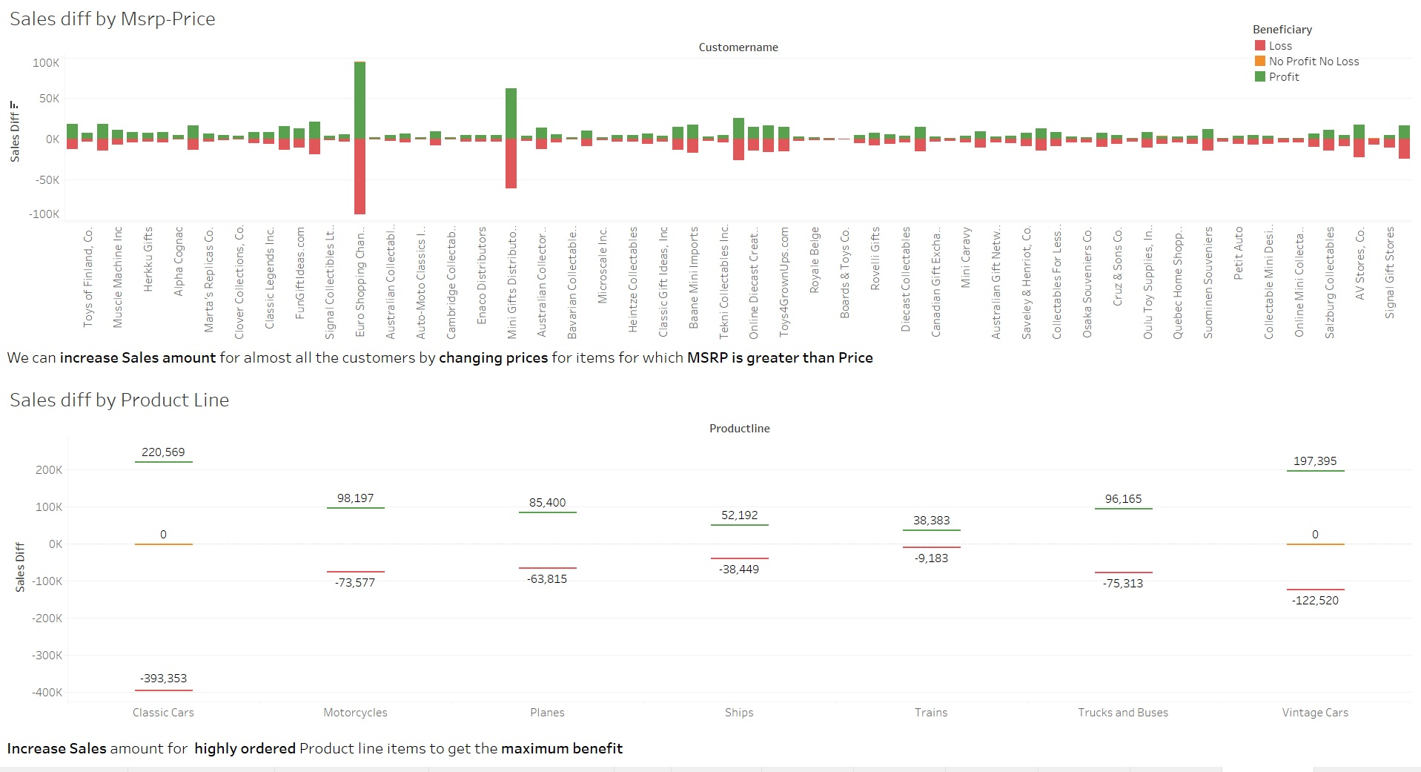

Slide 14
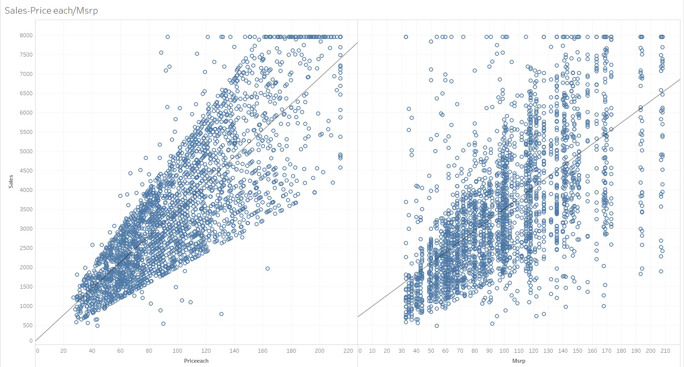
Sales-Price each/Msrp
From the plots , we can see there is higher spread of data along the trend line for Msrp compared to Price each. So we need to maximize sales by identifying respective items for which there is higher price change.

Slide 15
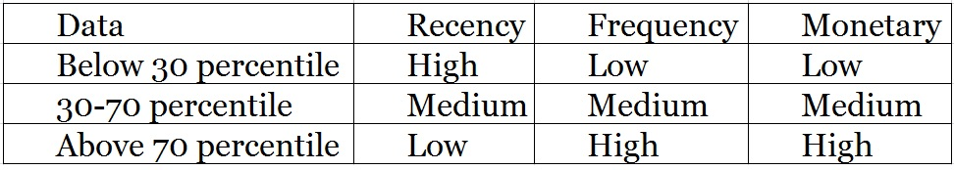
Customer Segmentation using RFM analysis
Customer Segmentation done by using KNIME and MS Excel by dividing the data based on Receny,Frequency and Monetary variables through grouping data by variable ‘CustomerName’
Recency – Min of variable ‘DAYS_SINCE_LASTORDER’
Frequency – Unique count of variable ‘ORDERNUMBER’
Monetary – Sum of variable ‘SALES’
Receny , Frequency and Monetary variables are divided into three bins based on percentile of respective column data.

Slide 16
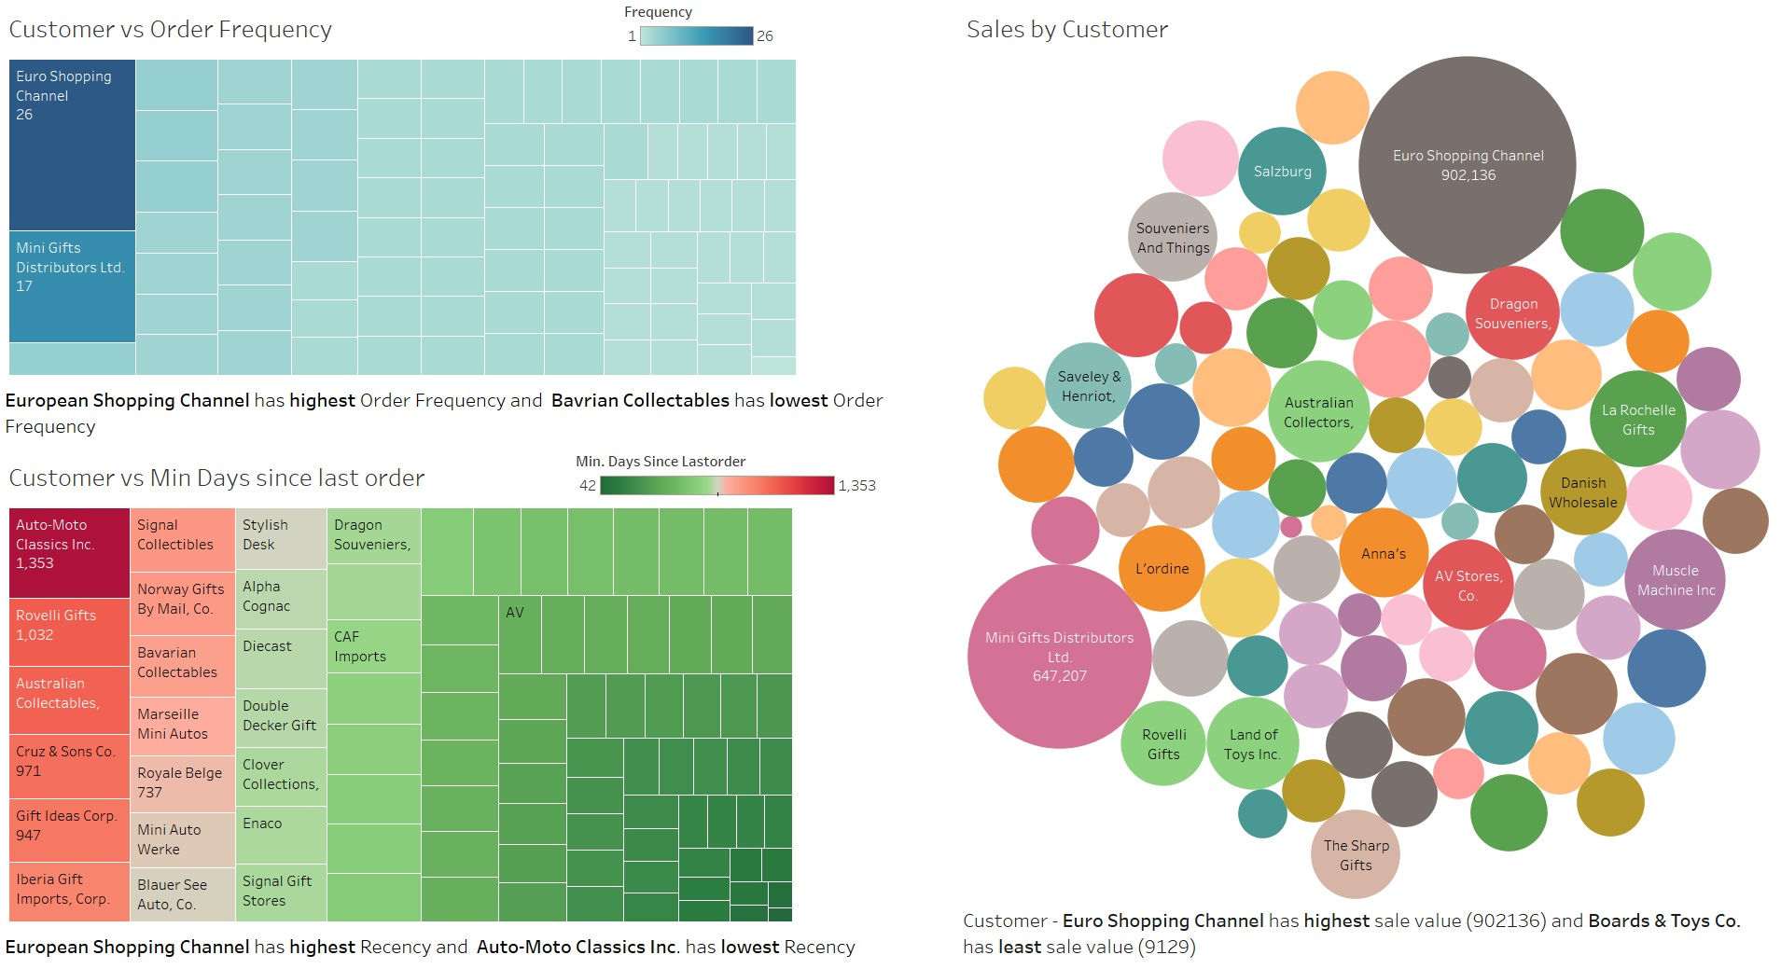

Slide 17
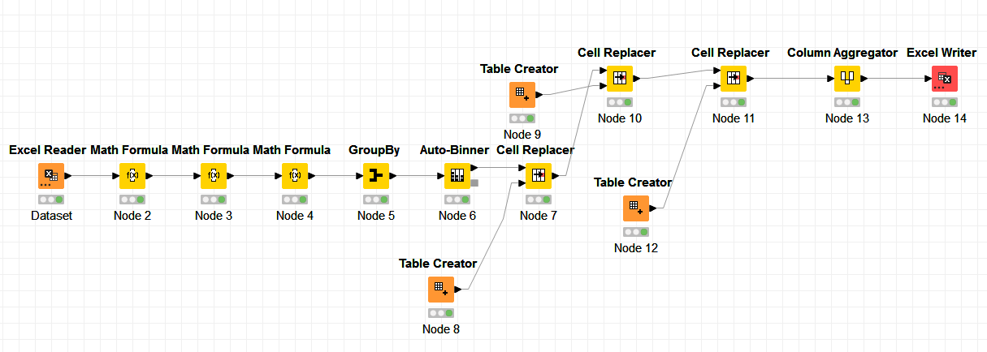
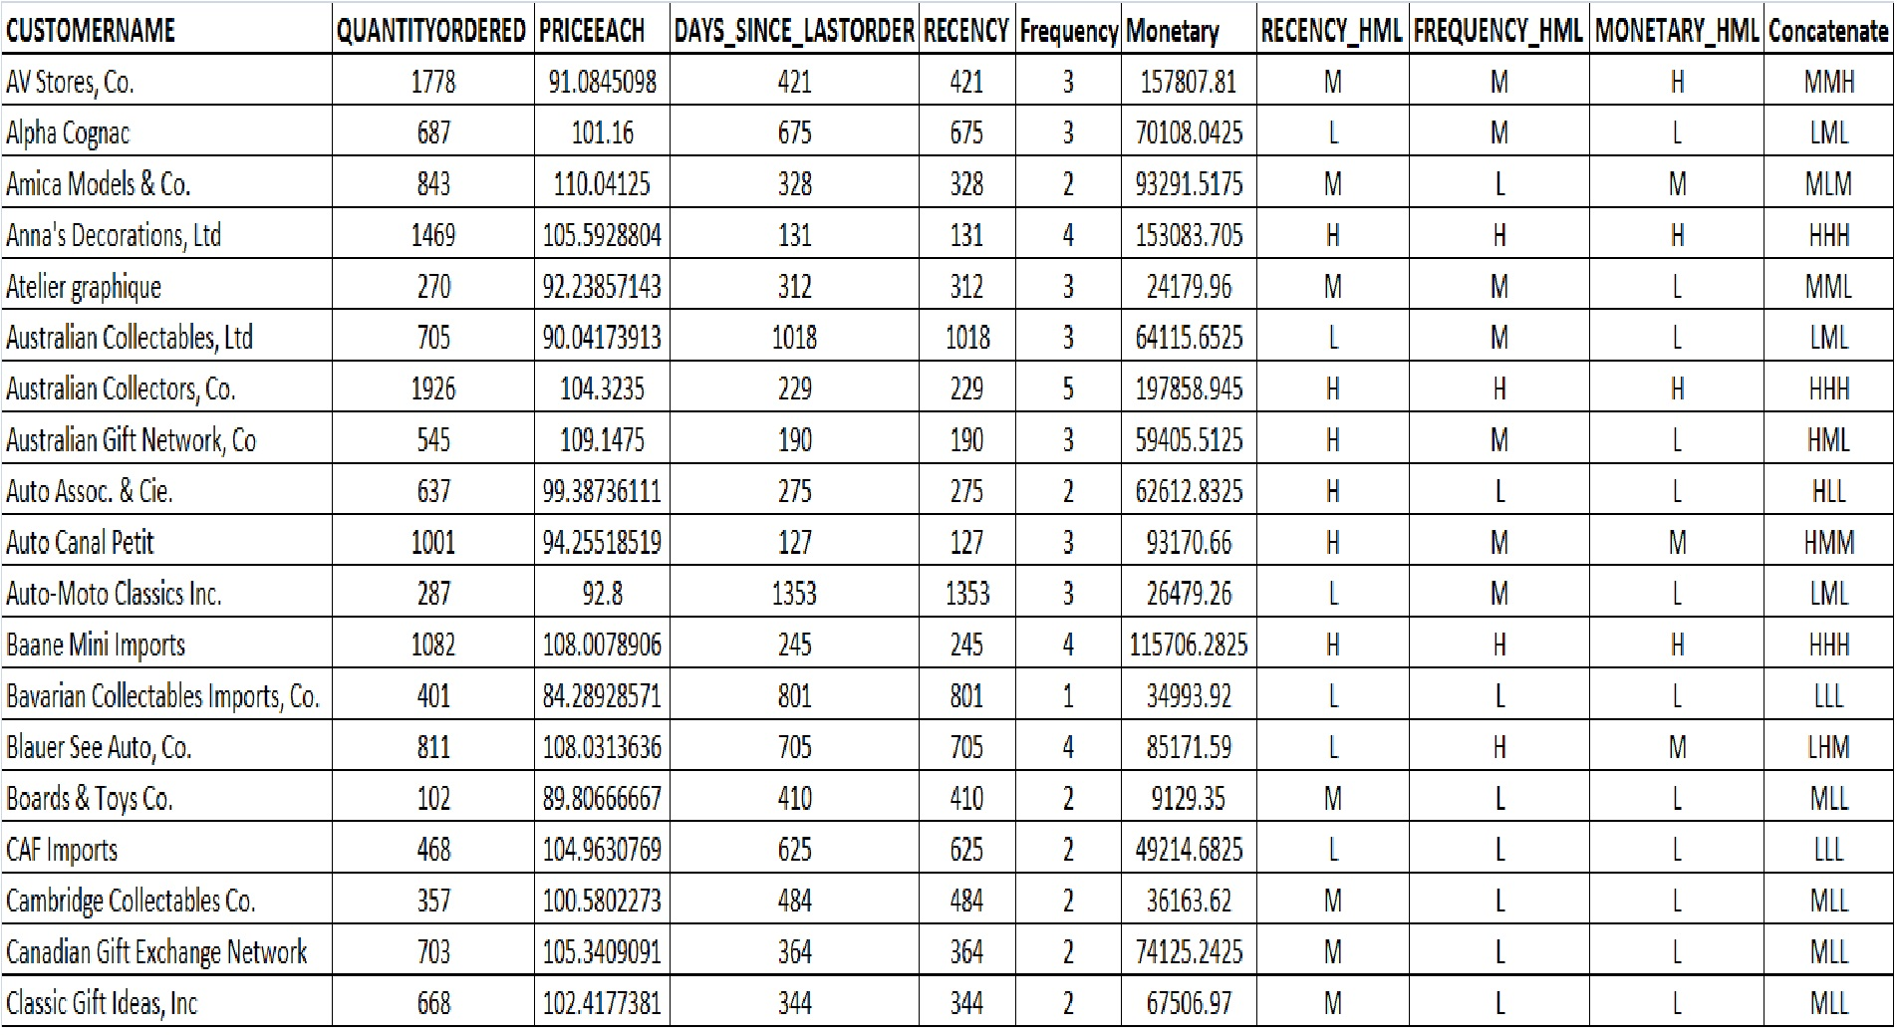
KNIME WorkFlow Image and Output Table Head

Slide 18
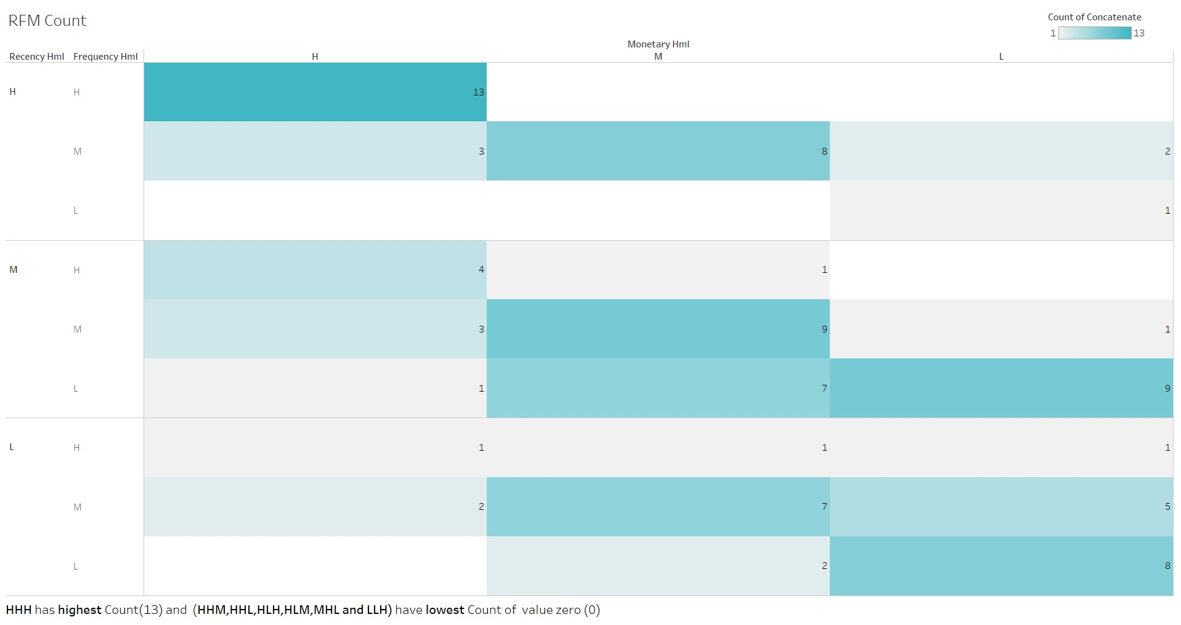
Inferences from RFM Analysis and identified segments

Slide 19
We have got customers in three type of groups based upon most important aspect –’Receny’
Active : Customers with High Recency – 27 Nos
These are the Most active customers as they belong to top 30 percentile of the customers and they play most important role in the business.
At-Risk :Customers with Medium Recency -35Nos
These are the Fairly active customers as they belong to middle 40 percentile of the customers. Need to concentrate on the customers otherwise we are at risk of losing them.
Inactive :Customers with Low Recency -27Nos
These are the least active customers as they belong to bottom 30 percentile of the customers. We can think of these the customers only after satisfying the needs of Active and At-Risk group customers

Slide 20
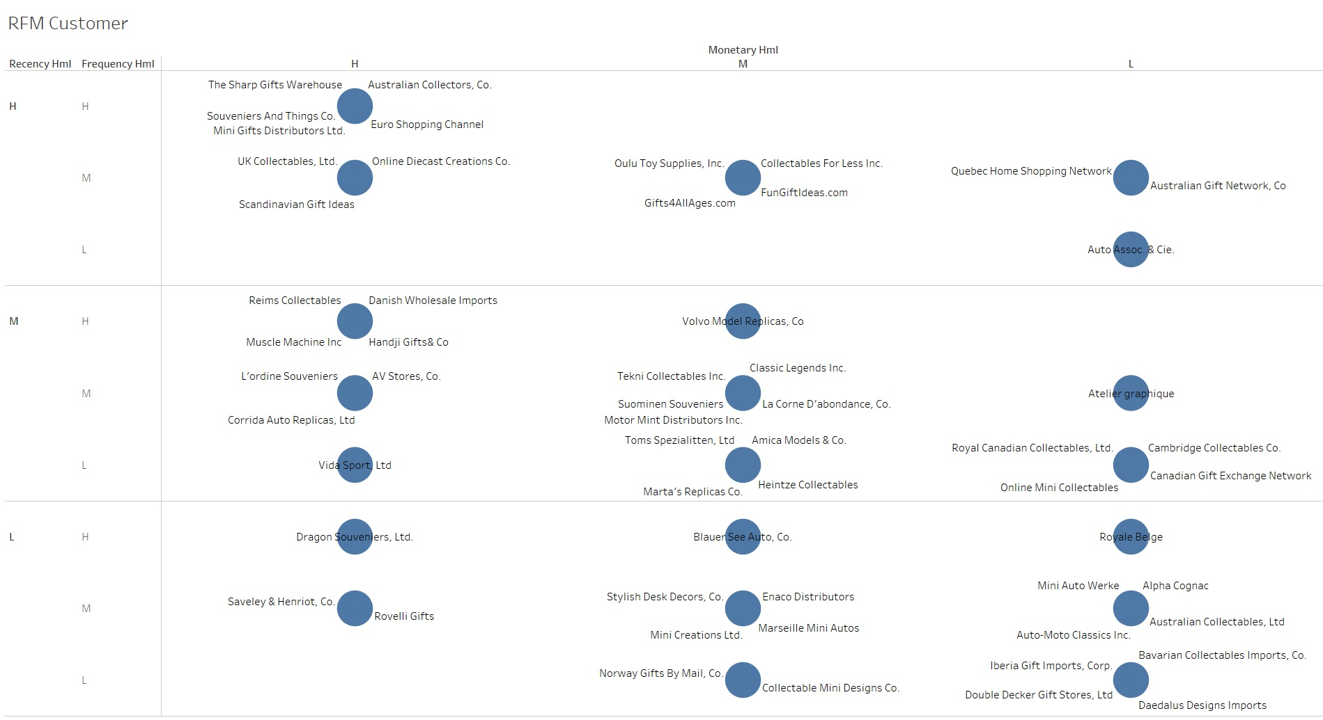

Slide 21
Best Customers – HHH-13 Nos
These are the most valuable customers as they are with High level in all the three aspects Receny, Frequency and Monetary.We should not loose these customers at any cost as they are the biggest contributors of the business.
Anna's Decorations, Ltd Australian Collectors, Co. Baane Mini Imports Diecast Classics Inc. Euro Shopping Channel La Rochelle Gifts Land of Toys Inc. Mini Gifts Distributors Ltd. Salzburg Collectables Souveniers And Things Co. Technics Stores Inc. The Sharp Gifts Warehouse Tokyo Collectables, Ltd
Better Customers – HHM,HMH,HMM-11Nos
These are the still valuable customers as they are with better level in all aspects Frequency and Monetary. We have to look after the needs of these customers to bring them into the pool of best.
Auto Canal Petit Collectables For Less Inc. FunGiftIdeas.com Gift Depot Inc. Gifts4AllAges.com Lyon Souveniers Oulu Toy Supplies, Inc. Toys of Finland, Co., Online Diecast Creations Co. Scandinavian Gift Ideas UK Collectables, Ltd.

Slide 22
Good Customers – HLH,HLM,HLL,HHL,HML-3 Nos
These are customers as average level in all the aspects Frequency and Monetary.We can still concentrate on them to increase business as they have got High Receny level.
Australian Gift Network, Co Quebec Home Shopping Network, Auto Assoc. & Cie.
Bad Customers –LLL-8Nos
These are the most avoidable customers as they are with lowest level in all aspects Receny, Frequency and Monetary. There is no point in spending time and effort to maintain business with these customers.
Bavarian Collectables Imports, Co. CAF Imports Clover Collections, Co. Daedalus Designs Imports Diecast Collectables Double Decker Gift Stores, Ltd Iberia Gift Imports, Corp. Signal Collectibles Ltd.

